Slide 1
Pharmacovigilance: Protecting Your Employees

Slide 2
Pharmacovigilance: Protecting Your Employees
Presented by:
Phil Walls, RPh
Chief Clinical Officer
myMatrixx
Learning Objectives
Recognize that approval of a drug by the FDA is not the end of its evaluation, but rather a transition to post-marketing surveillance.
Understand that the modern-day role of a clinical pharmacist is to evaluate drug therapy in terms of risk versus benefit.
Define de-prescribing and recognize when it should be employed.

Slide 3
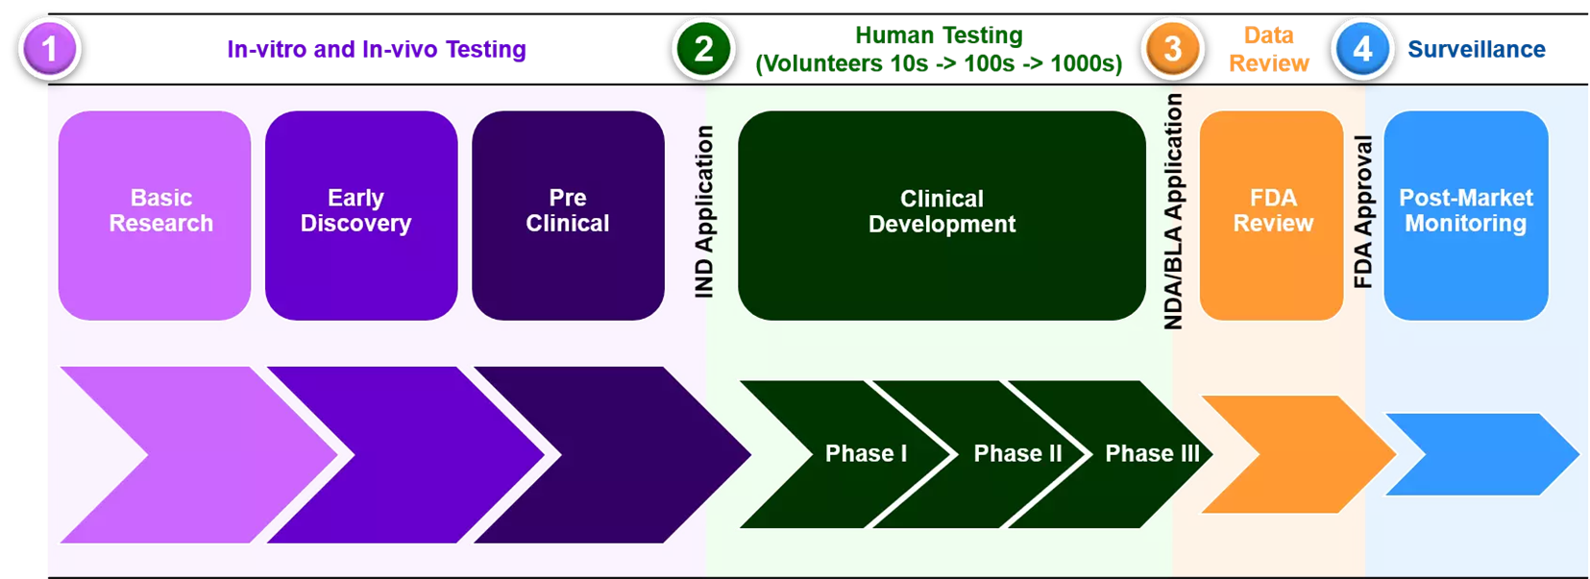
Pharmacovigilance
A significant component of post-marketing surveillance that occurs after a drug reaches the market following clinical trial
www.nebiolab.com/drug-discovery-and-development-process/

Slide 4
What is a PBM?
Pharmacy Benefit Management
On-line adjudication of prescription claims
Based on standards developed by the National Council for Prescription Drug Programs (NCPDP)
NCPDP is an ANSI-driven organization
Manages formularies and rules on behalf of payers
Provides clinical and compliance oversight
Not a PBA!

Slide 5
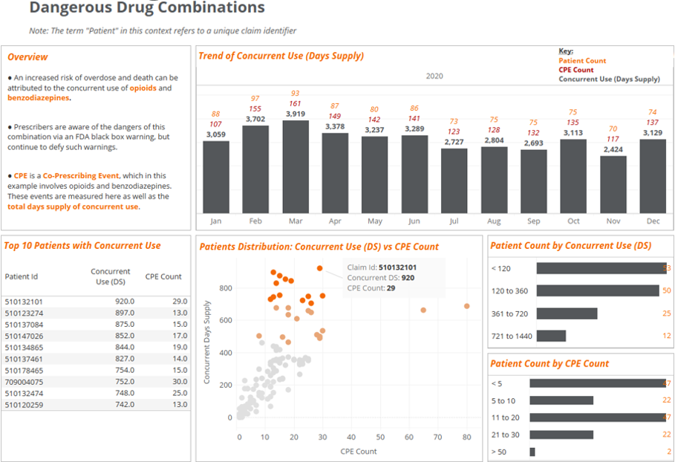
Aspects of Pharmacovigilance
Data Collection
Passive
Mandatory
Active
Data collecting Tools
Data Analysis and Reporting
Taking Action

Slide 6
Pharmacovigilance: Identifying Trends

Slide 7
Pharmacovigilance: Updating Patient Care
Morphine Equivalent Dose is a way to measure the “opioid load” of all the different opioids a patient may be taking and express that amount in terms of morphine dose
When a patient exceeds an MED of 50mg per day, the risk of overdose increases by a factor of 2
In a Veterans Health Administration study over 5 years, patients that died from an opioid overdose were prescribed an average MED of 98mg per day while those that survived were prescribed an average of 48mg per day

Slide 8
Factors influencing opioid burden decline
FDA’s Risk Evaluation and Mitigation Strategy (REMS)
Prescriber education
From drug manufacturers
From clinical pharmacists
Prescription Drug Monitoring Programs (PDMPs)
CDC’s Overdose Data to Action (OD2A): a 3-year cooperative agreement through which CDC funds health departments in 47 states, Washington DC, two territories, and 16 cities and counties for surveillance and prevention efforts.
Early Spike Detection in California
Harm Reduction in Michigan
Provider Education in Oklahoma
Collaborations with Public Safety in Washington

Slide 9
Strategies for mitigating risk
At-risk patient identified by clinical pharmacist, claims professional or nurse
Permission is requested to conduct a pharmacist to prescriber consultation
Consultation conducted with the claims professional or nurse when appropriate
If necessary, case may be escalated to Medical Director
A prescriber signed copy of the consultation is provided to all parties

Slide 10
Strategies for mitigating risk (cont.)
Weaning off medication
Process of tapering
Compassionate Weaning
5 to 10% reduction per week
Pharmaceutical dosing not designed for this type adjustment
Requires a detailed weaning schedule
May involve switching to other opioids – based on MED
De-prescribing
Identifying medication a patient no longer needs
Must cancel remaining refills!
Often a natural consequence of reversing a prescription cascade

