Slide 1
Data, Technology, and AI in MSP:
A Smart Solution Guide to Medicare Compliance and Claims Solutions
June 13, 2022

Slide 2
Agenda
1
Top Minds Talk AI
2
Not Science Fiction
AI in Claims & MSP Compliance
3
4
Q&A

Slide 3
1
Top Minds Talk AI

Slide 4
Top Minds are Talking About AI
“The development of full artificial intelligence could spell the end of the human race….It would take off on its own, and re-design itself at an ever-increasing rate. Humans, who are limited by slow biological evolution, couldn’t compete, and would be superseded.”
“AI doesn’t have to be evil to destroy humanity – if AI has a goal and humanity just happens to come in the way, it will destroy humanity as a matter of course without even thinking about it, no hard feelings.”
Stephen Hawking, Theoretical Physicist, Cosmologist, and Author
Elon Musk, Technology Entrepreneur, and Investor
Notes:
John Hagel, Author and Consultant who spent 40 years in Silicon Valley

Slide 5
Top Minds are Talking About AI
“If we do it right, we might be able to evolve a form of work that taps into our uniquely human capabilities and restores our humanity. The ultimate paradox is that this technology may become a powerful catalyst that we need to reclaim our humanity.”
John Hagel, Author and Consultant
“Robots are not going to replace humans, they are going to make their jobs much more humane. Difficult, demeaning, demanding, dangerous, dull – these are the jobs robots will be taking.
Sabine Hauert, Co-founder of Robohub.org

Slide 6
2
Not Science Fiction

Slide 7
Not Just Science Fiction Anymore
Larger Insurers investing heavily in AI products and services to:
Control claim costs
Engage claimants in their recovery
Utilize predictive models
AI determined the cause of 1.2 million claims and placed them into one of three categories: ergonomic related; slips, trips and falls; or all other categories combined.
It took the revised computer program less than 3 hours to categorize.
Assuming an average manual coding rate of 2.2 claims per minute, it would take a human 4.5 years to categorize all of these claims.
National Institute for Occupational Health and Safety and the Ohio Bureau of Workers’ Compensation

Slide 8
3
AI in Claims & MSP Compliance

Slide 9
Injury Prevention
Review of safety measures vs. data elements
Specific to your organization
Soter Analytics/SoterCoach wearable device monitors the behavior of workers and alerts of any hazardous movements that could lead to back or shoulder injuries. The sensor ups awareness of any hazardous movements such as twisting and coaches the worker on how to avoid these, and a dashboard displays data for employers to spot trends.
"With predictive safety modelling, it is possible to anticipate potential safety hazards through the interpretation of data. This is a powerful lens that can turn a usually reactive approach to workplace safety into a strong proactive one.”
AI collects and evaluates data to identify patterns, producing best data analytics and the ability to make predictions as algorithms detect the quality of movements performed. The safety of any given movement can be assessed against characteristics including velocity, jerkiness and bend angle.
Most common types of injuries
Body parts impacted
Areas injuries occur
Types of safety measures previously utilized
Notes:
A theme you may know from B&B
This is the year our organization will come together as a community
More information about this shortly
New playbooks and peer to peer program to launch in March

Slide 10
Case Control
Good Data
Accurate Data
Injury Report
Good versus bad data
Making sure data is accurate and complete
Starts with first report of injury
Claim Costs
Documentation
Lack of claim documentation and data limits ability to control claim costs i.e., prescription drug costs, medical treatment, unrelated vs. related injuries
Documentation is key to legal arguments, conditional payment disputes, Medicare Set-Asides and Section 111 Reporting
Transparent reporting is key to sound decisions
Notes:
A theme you may know from B&B
This is the year our organization will come together as a community
More information about this shortly
New playbooks and peer to peer program to launch in March

Slide 11
Claims Management
Time & Money
Overall Program
Time and money considerations
More than just a chronology - use not only this file but in overall program
Medical Records
Key Events & Searches
Key Words & Events
Managing medical records
Consider using vendor to provide medical chronology with key events and customizable searches
Model based upon keywords and events (i.e., drugs, doctors, pre-existing injuries, co-morbid conditions, motor-vehicle accidents)

Slide 12
Claims Management
Model based on key words and events
Types of prescriptions
Types of Providers
Settlement
Pre-existing injuries and co-morbid conditions
Litigation
Automobile Accident

Slide 13
Claims Management
Medical AI Tools
Unrelated Treatments
Detect Fraud
Prior Settlements or Injuries
Excessive Treatment
Help prevent payments for unrelated treatment or medications
Detect potential fraud
Detect prior settlement or injuries
Determine providers who prescribe excessive treatment
Notes:
A theme you may know from B&B
This is the year our organization will come together as a community
More information about this shortly
New playbooks and peer to peer program to launch in March

Slide 14
Reserves/Future Allocations
Reserve amounts
Future allocations
Utilizing
CMS Data / Org Data
Deviations from
Standards of Care
Triage and mitigate
claims

Slide 15
Negotiations and Settlement
Harnessing Data Elements
Awards based on jurisdiction
Attorney
Type of injury
Judge
Claimants counsel / prior demands
Allocations for same body part

Slide 16
Section 111 Reporting
Leveraging Data at Your Fingertips
01
Vast amount of data at your fingertips
02
Query Response -data on claim population
03
Use reporting data for CP disputes to ensure consistent responses
04
TPOC information to monitor settlement amounts
05
ICD-Coding to determine most common injuries
06
Dependent on system you are utilizing
Notes:
Query Response-data on claim population i.e. volume of Medicare beneficiaries vs. non-Medicare-covered impacts potential conditional

Slide 17
Concerns and Considerations
HYBRID APPROACH
SECURITY
Hybrid approach to data and AI
Privacy and security concerns
CREATE V. PURCHASE
LAWS VARY
Costs of creating in-house AI program vs. vendor data solutions
Differing state workers’ compensation laws and systems
“AI's ability to make meaningful predictions -- to get at the truth of a matter rather than mimic human biases -- requires not only vast stores of data but also data of high quality.”
Linda Tucci, Industry Editor -- CIO/IT Strategy

Slide 18
Q&A

Slide 19
Thank You for Your Time
bsmith@impaxx.com
855.6.IMPAXX
http://www.impaxx.com

Slide 20
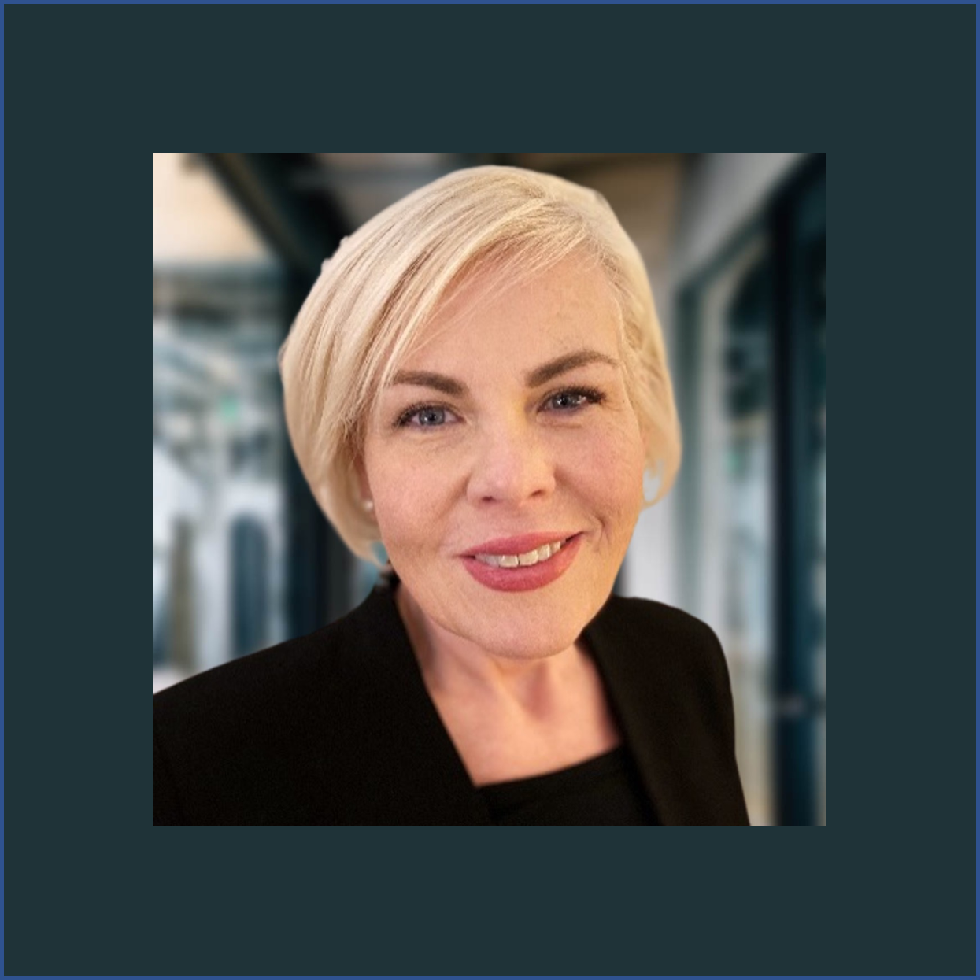
Your Presenter
Bridget Smith
Vice President, MSP Compliance and Customer Relations

