Slide 1
Regulatory Trends to Watch: COVID‐19 Effects & More,
Michele Hibbert
Lisa Anne Bickford

Slide 2
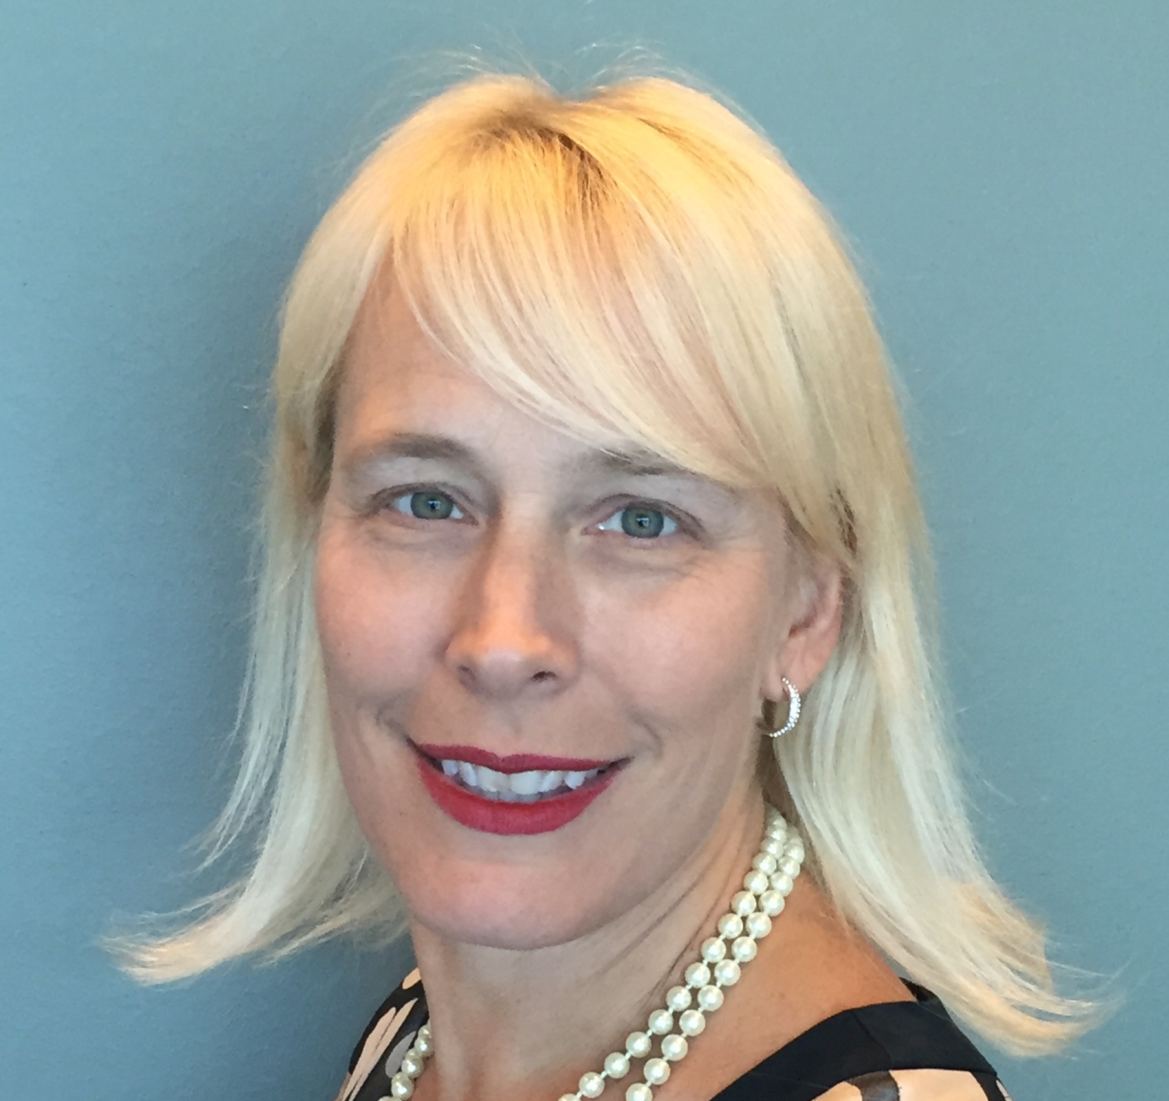
Today’s Presenters
Michele Hibbert
Senior Vice President, Regulatory Compliance Management, Mitchell
Lisa Anne Bickford
Director, Government Relations, Coventry

Slide 3
10% Charge per Unit
8% Allowed per Unit
Workers’ Compensation Severity Increases Since 2017
© 2022 Risk and Insurance Management Society, Inc. All rights reserved. Confidential and Proprietary. Do not disclose without written permission from RIMS General Counsel.

Slide 4
Federal Trends
2022

Slide 5
Federal Trends
No Surprises Act
Marijuana
Telemedicine
Centers for Medicare & Medicaid Services (CMS) & Inpatient-Only List
Federal Trade Commission (FTC) and Department of Justice (DOJ) Mergers & Acquisitions
Political Landscape
Notes:
No surprises – michele
Marijuana – Brian
Telemedicine – Lisa Anne / Michele?
CMS – Lisa Anne / Michele?
DOJ & Mergers and acquisitions – lisa anne

Slide 6
COVID-19 Effects on Regulations
2022

Slide 7
Post-Pandemic Legislative Landscape
Emergency Legislation
Direction of Care
Long-Haul & Prescription Costs
Presumptions
Notes:
Is the emergency legislation related to sunsetting?

Slide 8
State-Specific Issues
2022

Slide 9
Workers’ Comp State Updates
NV
NY
IL
IN
CA
CO
PA
NJ
NV
IN
CA
IL
KY
TX
TX
FL

Slide 10
Thank You!
Michele Hibbert | Michele.Hibbert@mitchell.com
Lisa Anne Bickford | bickfordl@cvty.us.com
Visit www.enlyte.com for more regulatory and compliance content.

