Slide 1
Social Determinants of Health in Workers Compensation Claims
Mollie Kallen, MS, CRC, CCM - CEO MKCM, Inc.
Rafael Gonzalez, Esq – Partner Cattie & Gonzalez
Mark Pew – Principal Rx Professor and Provost/Co-Founder WorkCompCollege.com

Slide 2
Social Determinants of Health
The conditions in which we are born, live, learn, work, play, worship, and age – known as social determinants of health (SDOH) – have a profound impact on health. They influence the opportunities available to us to practice healthy behaviors, enhancing or limiting our ability to live healthy lives.

Slide 3
Definition of SDOH
What is it?
Why is it important?
How does it impact Worker’s Compensation?
How does it impact medical care and treatment?
Why do we need to pay attention to it?
What types of changes will it impact on our industry?
External and internal SDOH
Financial advantage

Slide 4
What are the Social Determinants of Health?

Slide 5
Economic Stability
Income level and the ability to secure financial resources affects everything from where people live, to what foods they can afford and whether they can pay for healthcare, childcare and transportation.

Slide 6
Education Access
Education Access - Language, literacy, and the level of education someone attains affects health outcomes. People with higher education are more likely to have higher levels of income, able to meet essential family needs, live in safer neighborhoods, and eat healthier foods.

Slide 7
Healthcare Quality
The ability to access quality healthcare from physicians, clinics, hospitals, and other facilities and providers, and understanding when and how to seek care—health literacy—are important components of positive health outcomes.

Slide 8
Neighborhood
People living in food deserts, communities with high crime or domestic violence, neighborhoods with poor air and water quality, lack of green spaces, and buildings with asbestos and insects, are significantly more likely to have poor physical and mental health.

Slide 9
Social Environment
Social connectedness and a supportive community foster better health.
Loneliness and isolation can reduce life expectancy and lead to chronic mental and physical conditions.
Isolation is a social risk factor that predicts mortality in a similar way to clinical risk factors.
Racism, ethnic and religious discrimination, and dysfunctional family environments act similarly to social risk factors.

Slide 10
Approach to Social Competency
Social factors impacting health
Economic Stability
Physical Environment
Education and Literacy
Food Access, Quality, and Education
Community and Social Context
Healthcare System
Focus on a whole-person approach to recovery of the patient to increase resiliency and self-efficacy:
Claim management
Employer – Zip Codes/ Z Codes
Advocacy and alignment
Engagement with patient, employer, and physicians

Slide 11
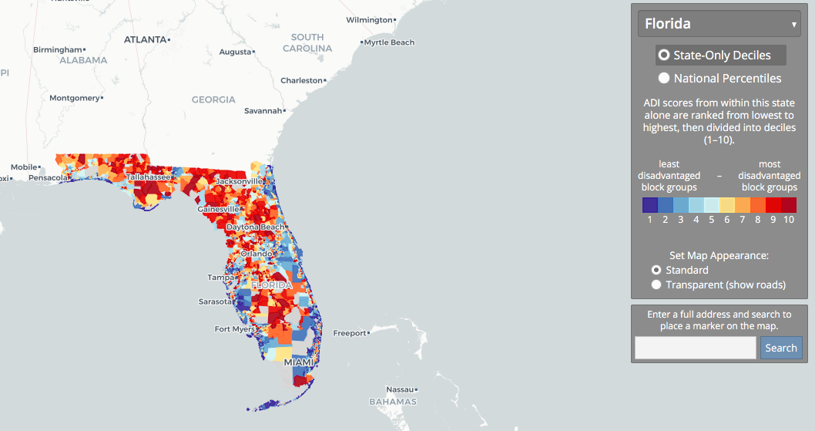
https://www.neighborhoodatlas.medicine.wisc.edu
Screen shot and web address

Slide 12
ICD Z Codes
In 2015, the International Classification of Diseases medical coding system expanded its section of healthcare claims codes to capture SDOH. These codes, commonly referred to as Z codes, generally are used alongside a primary diagnosis code that describes the illness or injury a patient presents with.

Slide 13
Using Z Codes in Work Comp
When using Z codes providers can detail about an injured worker’s SDOH and provide the employer, insurer, and claims handler details about specific issues or needs
Concern areas are: food, housing, transportation, education, violence, employment and other factors that influence health.

Slide 14
Examples of Z Codes
Sample Z Codes
Z55: Problems related to education and literacy
Z56 Problems related to employment and unemployment
Z57: Occupational exposure to risk factors
Z59: Problems related to housing and economic circumstances
Z64: Problems related to certain psychosocial circumstances

Slide 15
Z Code Details
Z codes have subcodes for underlying socioeconomic or psychosocial health issues. For example:
Z56.2 threat of job loss,
Z56.3 stressful work schedule,
Z56.4 discord with boss and workmates
Z59.0 indicates homelessness
Z59.6 indicates low income

Slide 16
Slow Adoption of Z Codes
Adoption of Z codes has been slow, especially among workers compensation medical providers, employers, insurers, and claim handlers.
Medicare/Medicaid buy in
W. Compensation providers not utilizing yet

Slide 17
6 Ideas to Get You Started - Takeaways
Collect Your Own Data
Helping Employees with Social Needs (External v. Internal)
Educate Employees About WC
Bring in Agencies and Platforms
Partner with Medical Institutions
Advocacy Organizations

