Slide 1
Opportunity in crisis
How To identify & engage stakeholders to convert crisis to success

Slide 2
Pandemic – short for Innovation Inspiration
Never allow a good crisis go to waste when it's an opportunity to do things that you had never considered, or that you didn't think were possible.
– Rahm Emanuel
2

Slide 3
A time of change
What We Face
What We Need
Ability to intake a vast amount of data and condense it down into a compelling vision
Ability to communicate that vision in a way that inspires and motivates others to support a common goal
Ability to adjust to change rapidly
A rapidly changing landscape: culturally, technologically, economically
New challenges and new technologies
Lack of Certainty
Which Calls For
Individuals Sharing their Value
Flexibility & Collaboration
A Growth Mindset

Slide 4
Foundation for success
Everyone is a stakeholder
Failure… Isn’t
Elephants are best consumed in small bites
Communicate Communicate Communicate
Success is not a finish line
You don’t know the problem
There is no finish line
Communicate Communicate Communicate
Keep it Bite Sized
Failure… Isn’t
You don’t know the problem
Fish with a net not a pole

Slide 5
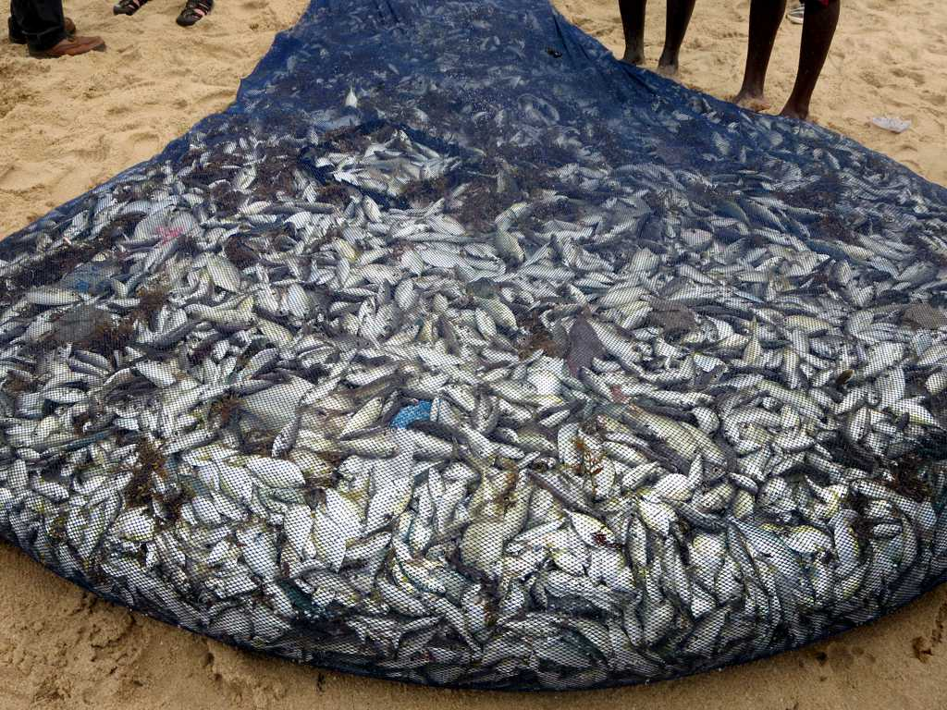
Fish with a net, not a pole
Stakeholder Potential
Regulators
Clients
Staff
Vendors
Industry members
Managers
Potential Partners are Everywhere
Who do you impact?
Who impacts you?
Who cares about your industry?
Who is positioned to have insight?

Slide 6
You Don’t know the Problem… Yet
Engage through Questions
Outcome 1:
Identify “THE” problem
Outcome 2:
Reinforced Relationships & opened lines of communication
Outcome 3:
New & better information
What’s working?
What’s not working?
What are your key concerns?
How can I help?

Slide 7
Failure…isn’t
Redefining failure for your stakeholders
In a growth mindset, challenges are exciting rather than threatening. So rather than thinking, oh, I’m going to reveal my weaknesses, you say, wow, here’s a chance to grow.
There is no fail, only “it worked as expected” or “it didn’t work as expected.”
Expect imperfection and give it value
Celebrate the process
– Carol S. Dweck

Slide 8
Keep It Bite Sized
Time
Set your approach to be
Small
Resources
Information
Aligned
Measurable
A crisis means you are short on…
Trust

Slide 9
Communicate, Communicate, communicate
Communicate with TRANSPARENCY
Communicate with PURPOSE
Communicate with FREQUENCY

Slide 10
There is no finish line
Attempt
Learn
Assess
“Success is the sum of small efforts, repeated day in and day out.” – Robert Collier

Slide 11
Ann Klein, President
aklein@majorishealthsystems.com
(503) 639-6080
11

